Slide 1



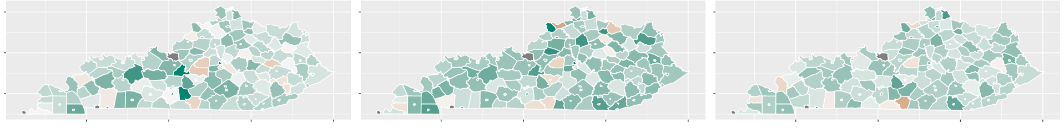
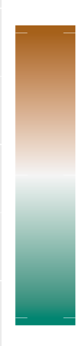
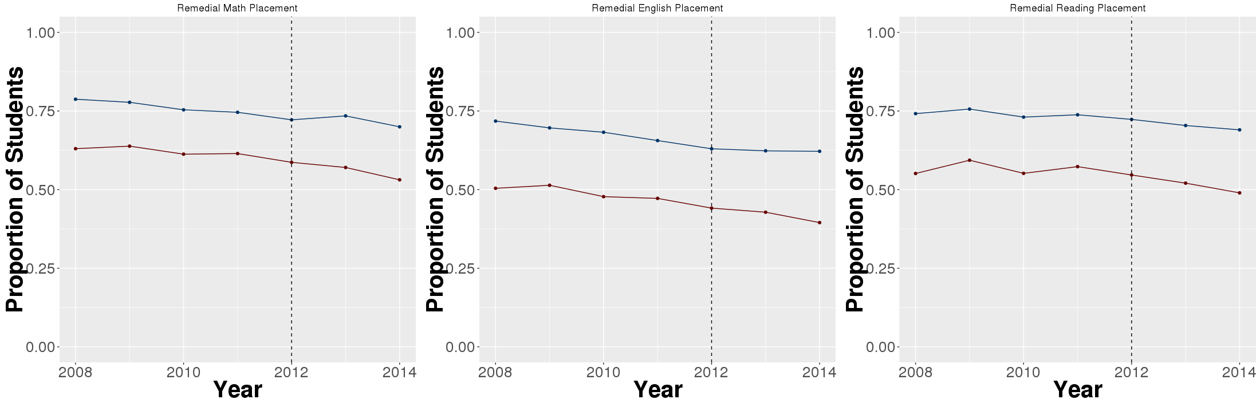
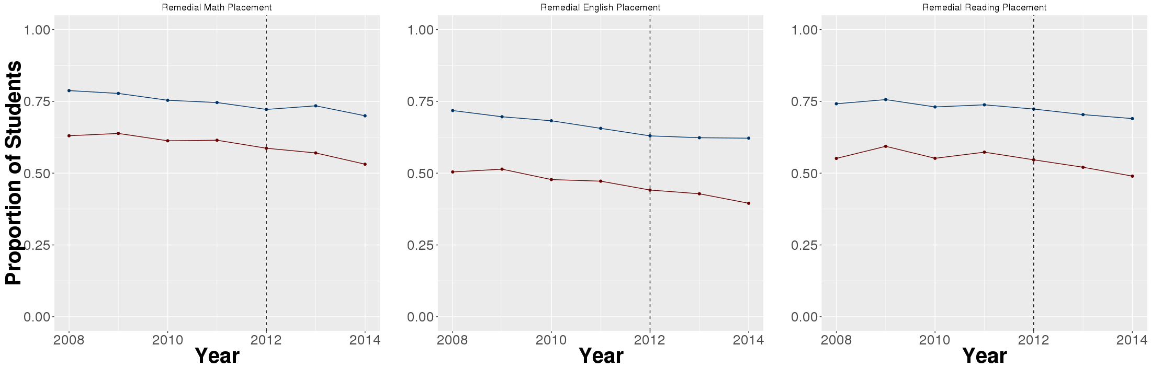
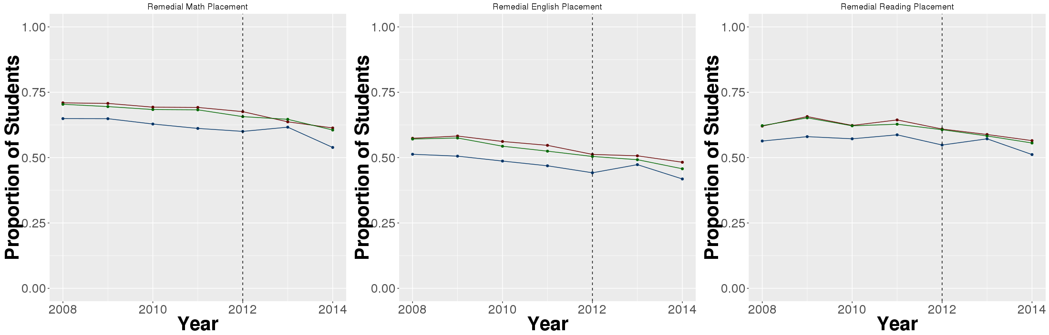
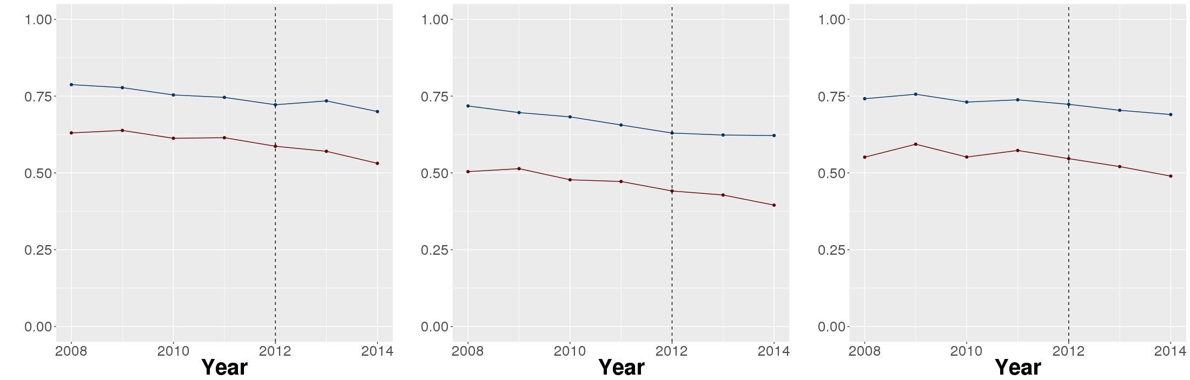
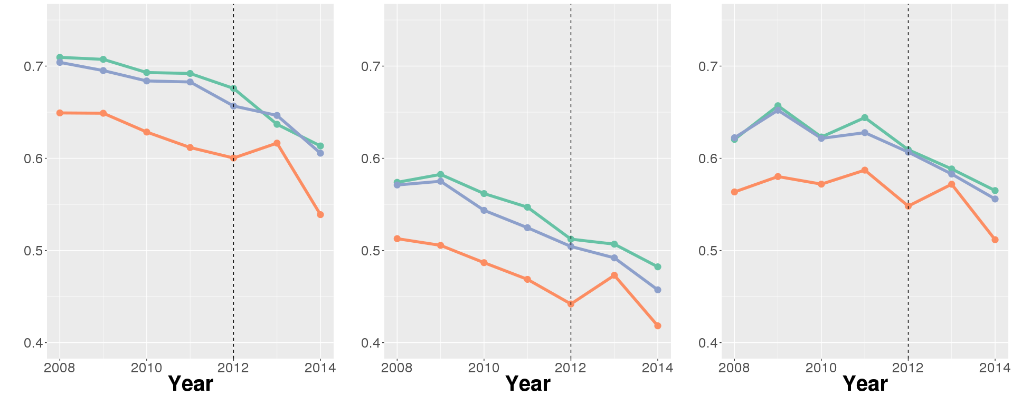
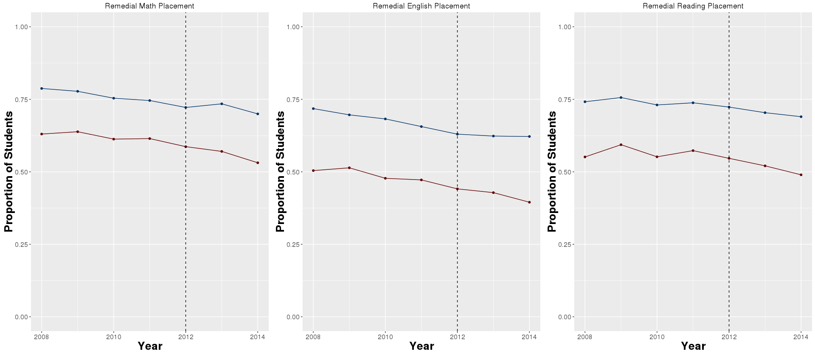
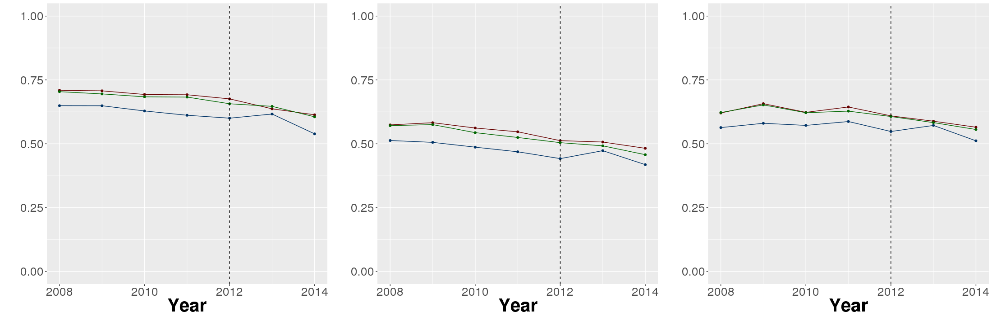

Assessing the Influence of Career
and College Readiness
Data Science for the Public Good
Emily Stark (Austin Peay State University) with Kathryn Ziemer (SDAL)
Introduction to Kentucky’s Policy
Overview of the Literature
2009 Senate Bill 1
The Kentucky Senate Bill 1 was passed to address the high rate of students enrolled in remedial courses during their first year of college.^{[1]} This bill created two benchmarks as a solution:
  College Readiness: meeting benchmarks on either the ACT, COMPASS, or KYOTE (college placement tests) indicating that they do not require placement in remedial college courses for Math, English, and Reading.^{[2]}
  Career Readiness: certification in an industry or testing above certain benchmarks on WorkKeys or ASVAB and KOSSA, in addition to completing coursework in Career and Technical Education curriculum.^{[2]}
  While these benchmarks were introduced in 2009, they were not tracked until the graduating class of 2012.
Defining Career and College Readiness
According to ACT, only 42% of the 2009 graduating class nation-wide is ready for a college Algebra course, 67% for an English course, and 53% for a Social Sciences/Reading course.^{[3]}
Additionally, studies have shown that high school graduates, college instructors, and employers all agree that high schools are not preparing their graduates for the next portion of their careers.^{[4]}
However, there is no consensus among states on the definitions of College and Career Ready.^{[5]}
While Kentucky is one of 9 states, as of 2012, to publish state-wide criteria,^{[6]} very few evaluative studies are available, and those that are provide a qualitative, rather than quantitative review of the policies.^{[7]}
All students in Kentucky take the ACT in 11th grade and their score is then used to determine if they will need to be placed in remedial courses should they choose to attend college.
Direct Evaluation of the Policy
Percent Change in Remedial Placement from 2009 to 2014 by School District, n = 169
50% Increase
Mathematics
English
Reading
No Change
These maps show the change in the proportion of students in each school district that would be placed in remedial courses based on their Junior Year ACT Score from the graduating class of 2010 to 2015.
The bill set the target that by 2014-15, remedial course placement should be half what it was in 2009-10.^{[1]}
Remedial placement was cut in half in only 5 districts for Mathematics, 5 districts for English and 0 districts for Reading. However, 96% of the state did show some improvement in at least one area.
Remedial course placement increased in 21 districts for Mathematics, 16 districts for English, and 17 districts for Reading.
Remedial Course Placement, All Districts Combined
Year | Math | English | Reading
2010 | 66% | 54% | 62%
2015 | 56% | 43% | 52%
Change | 15% ↓ | 20% ↓ | 16% ↓
50% Decrease
Differences by Race
Differences by Career Readiness
Differences in Remedial Placement by Race
Differences in Remedial Placement by Career Readiness
Proportion of Students
Proportion of Students
Math
English
Reading
Mathematics
English
Reading
Mathematics
English
Reading
White
Non-White
Low
Medium
High
Race
There was a general decline in remedial course placement across 2009-2014, however white students consistently performed better than non-white students.
Career Readiness:
Due to the unique requirements and goals involved with the career readiness indicators, we explored how career readiness may impact remedial course placement.
We found that districts with a higher proportion of Career Ready Students have a higher proportion of remedial course placement.
We do not see much difference between High and Medium Career Ready Districts.
References
^{[1]} Kentucky Department of Education and Kentucky Council on Postsecondary Education. (2010). Unified Strategy for College and Career Readiness Senate Bill 1 2009.
^{[2]} Career/College Readiness for All. (2015). http://education.ky.gov/educational/CCR/Pages/default.aspx
^{[3]} ACT(2009). ACT Profile Report - National: Graduating Class 2009. Iowa City, IA.
^{[4]} Peter D. Hart Research Associates. (2005). Rising to the challenge: Are high school graduates prepared for college and work? Washington, DC: Achieve.
^{[5]} Maruyama, D. (2012). Assessing college readiness: Should we be satisfied with ACT or other threshold scores? Educational Researcher, 41(7), 252-261.
^{[6]} Conforti, P. A. (2013). What is College and Career Readiness? A Summary of State Definitions. Pearson Bulletin, 22, 1-5.
^{[7]} Bragg, D. D., & Taylor, J. L. (2014). Toward College and Career Readiness: How Different Models Produce Similar Short-Term Outcomes. American Behavioral Scientist, 58(8), 994-1017. doi:10.1177/0002764213515231
bi.vt.edu/sdal
Notes:
[1] file:///C:/Users/Emily/Google%20Drive/2016%20Summer%20Projects%20for%20SDAL%20Fellows/SLDS/College%20and%20Career%20Ready/%20Literature/college_readiness_sg_unified_strategy.pdf
[2]
http://education.ky.gov/educational/CCR/Pages/default.aspx
[3] ACT Profile Report-National
[4] Are High School Graduates Prepared for College and Work?
[5]Assessing College Readiness: Should We Be Satisfied with ACT or Other Thresholds Scores?
[6] What is College and Career Readiness?
[7] Toward College and Career Readiness: How Different Models Produce Similar Short-Term Outcomes

